Slide 1
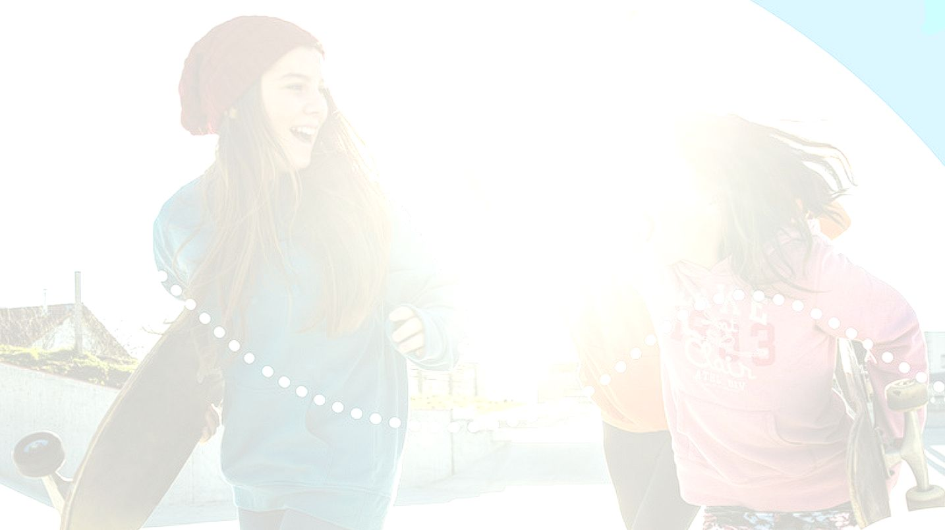


UNIT 2; My place, your place
Space home

Slide 2
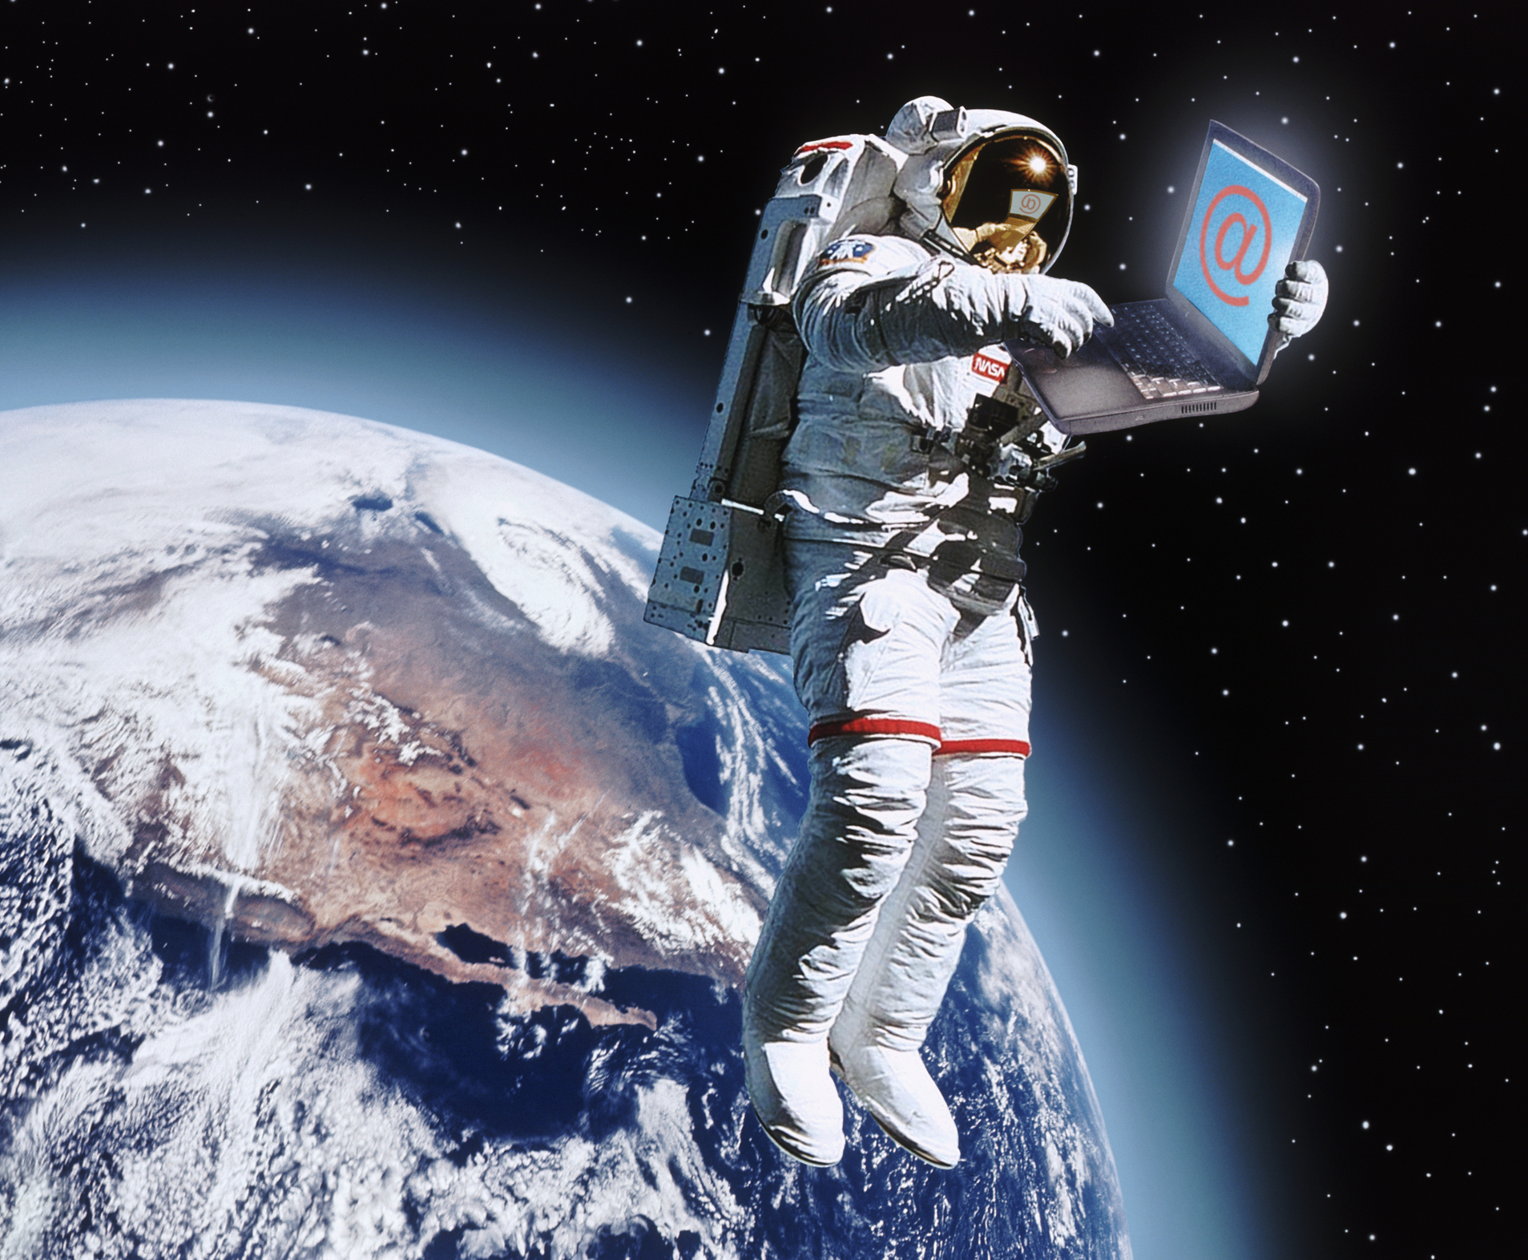
Would you like to travel to space?
How can people travel to space?
How long does it last, what do you think?
Who can travel to space?
How and what do they eat there?
What do they do the whole day?
Do they have showers on regular basis?
Do they communicate with the Earth?
Why do people go to space?

Slide 3
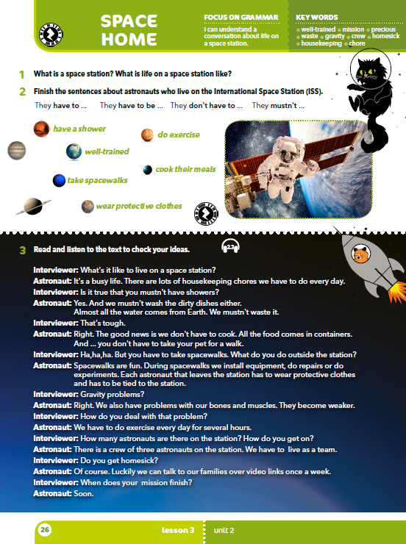
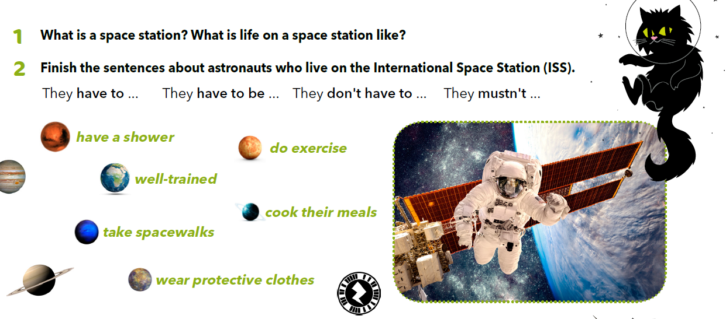
Finish the sentences about astronauts who live on the International Space Station (ISS).
MORAJU
MORAJU BITI
NE MORAJU
NE SMIJU
tuširati se
vježbati
istrenirani
kuhati vlastita jela
ići u šetnje svemirom
nositi zaštitnu opremu

Slide 4

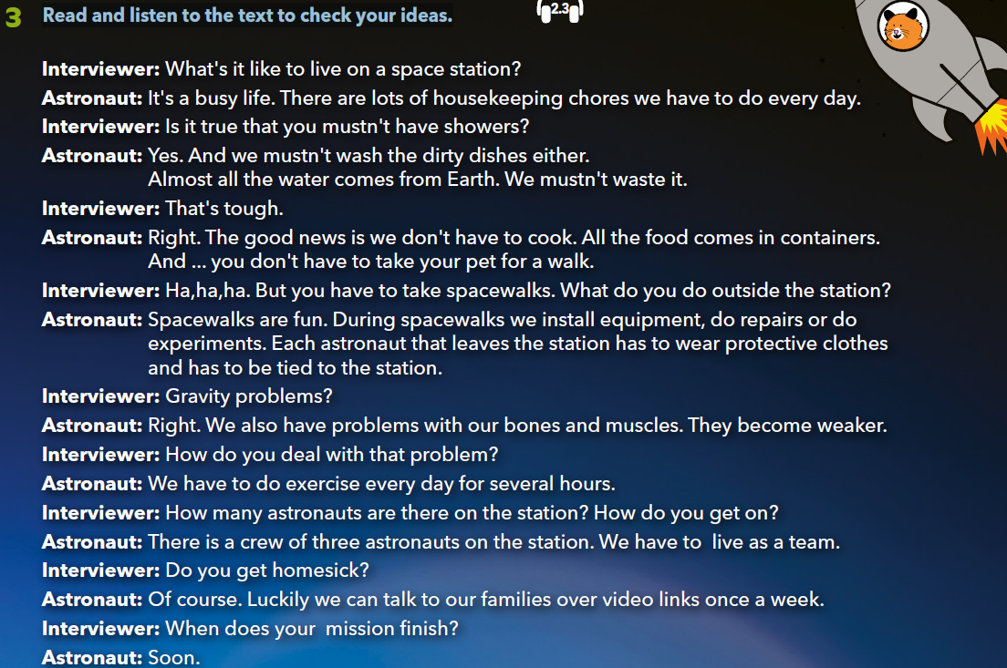

Read and listen to the text to check your ideas. https://www.e-sfera.hr/dodatni-digitalni-sadrzaji/1ec74b93-0475-4c6f-9d58-e323047cac44/assets/audio/05__unit_02_lesson_3_-_space_home_-_interview_with_an_astroanut_1.mp3

Slide 5
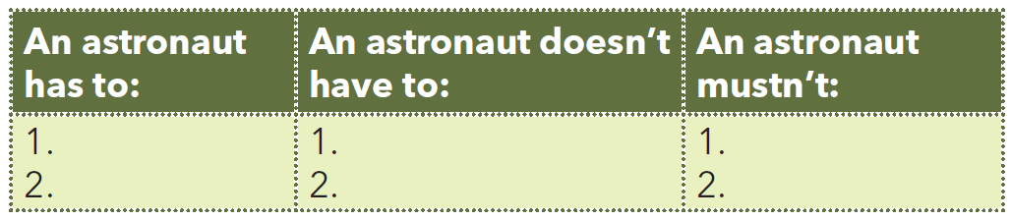
Open your notebook and write two things that an astronaut has to do, doesn’t have to do, mustn’t do!
take spacewalks
wear protective clothes
cook
take a pet for a walk
have showers
wash the dirty dishes
Check your knowledge: https://wordwall.net/play/636/814/948

Slide 6
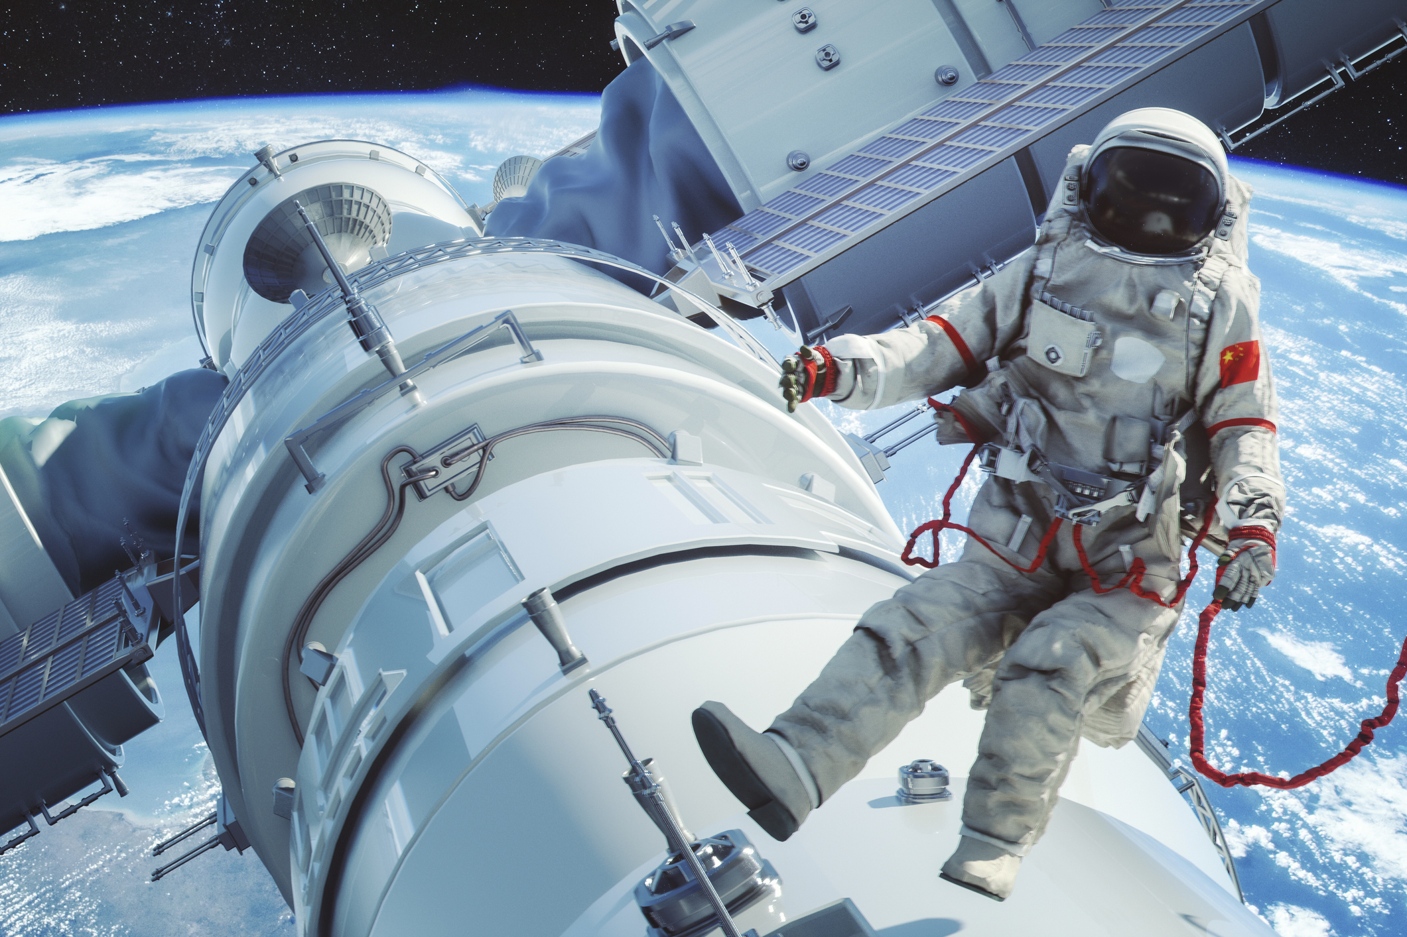
Why don’t astronauts wash the dishes?
What do they eat?
Do they like spacewalks? Why?
What do they do during spacewalks?
How are their chores different than yours?
Do they experience any gravity problems?
How do they deal with those problems?
What do they do when they are homesick?
How many people are there on the station?
Who would you take with you if you were an astronaut and you could choose your crew?

Slide 7
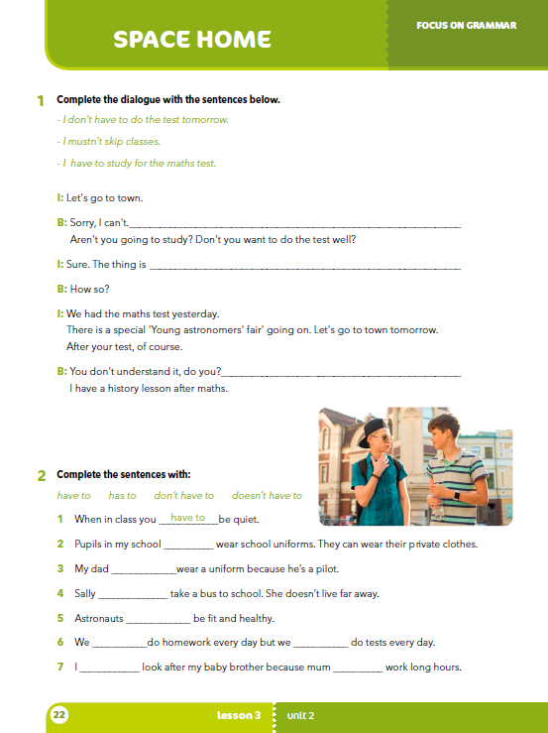
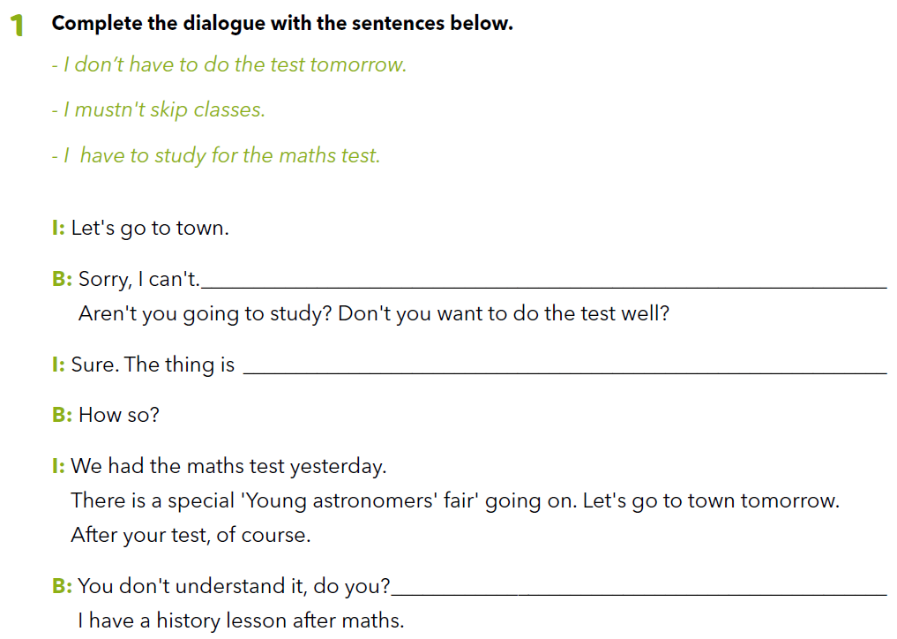
Workbook, p. 22
I have to study for the maths test.
I don’t have to do the test tomorrow.
I mustn’t skip classes.

Slide 8
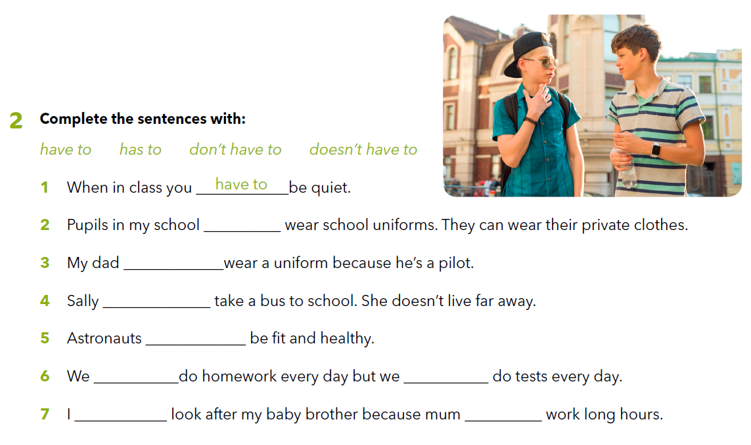
don’t have to
has to
doesn’t have to
have to
have to
don’t have to
have to
has to

Slide 9
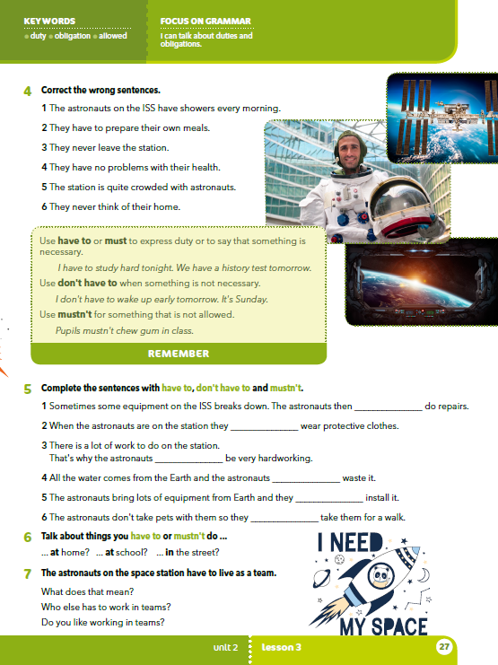
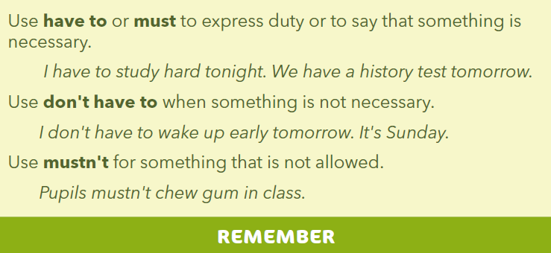
What does staying on a space station look like?
How does a household on a space station differ from our usual households?
What do you like about spending time on a space station and what do you dislike about it?
HAVE TO ili MUST koristimo za izricanje dužnosti ili kada želimo reći da je nešto nužno napraviti.
DON’T HAVE TO koristimo kada želimo reći da nešto nije nužno napraviti (ne trebamo nešto napraviti).
MUSTN’T koristimo kada želimo reći da nešto NE SMIJEMO napraviti.

Slide 10
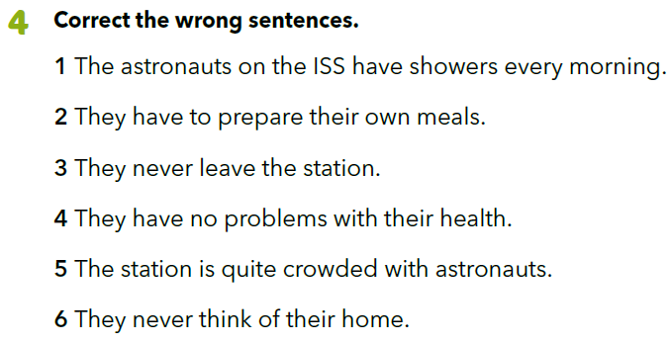
1 The astronauts on the ISS mustn't have showers.
2 They don't have to cook.
3 They leave the station and take spacewalks.
4 They have problems with their bones and muscles.
5 There are three astronauts on the station.
6 They get homesick.

Slide 11
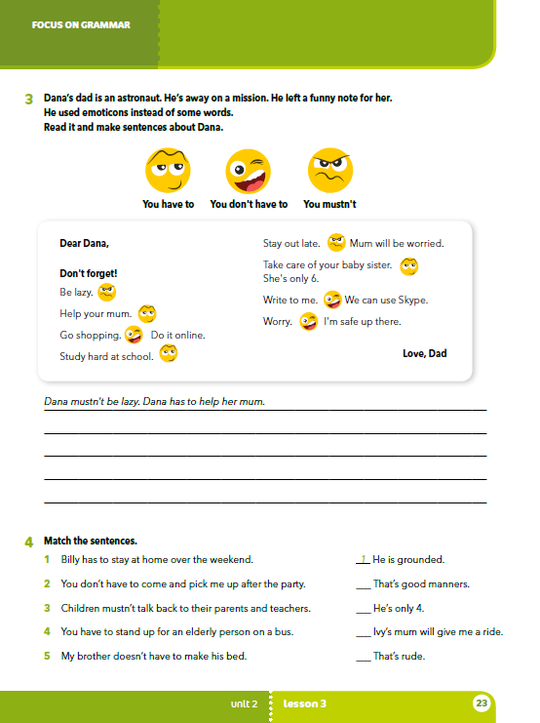
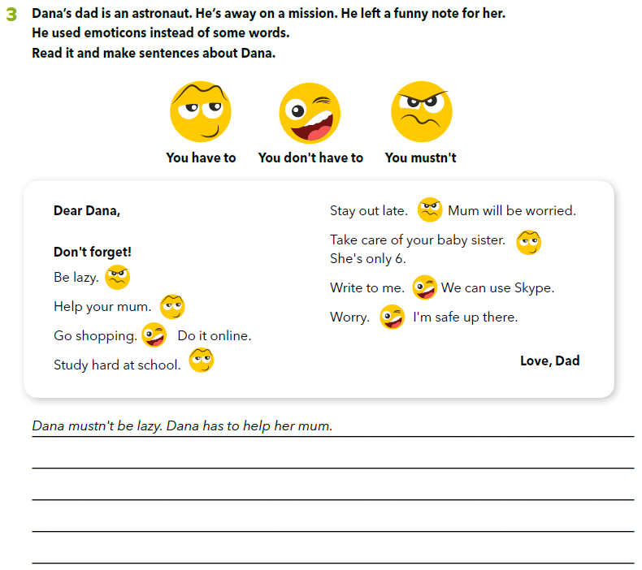
Workbook, p. 23
Dana’s dad is an astronaut.
He’s away on a mission.
He left a funny note for her.
He used emoticons instead of some words.
Read it and make sentences about Dana.
Dana doesn’t have to go shopping.
Dana has to study hard.
Dana has to take care of her
Dana mustn’t stay out late.
baby sister.
Dana doesn’t have to write to dad.
Dana doesn’t have to worry.

Slide 12
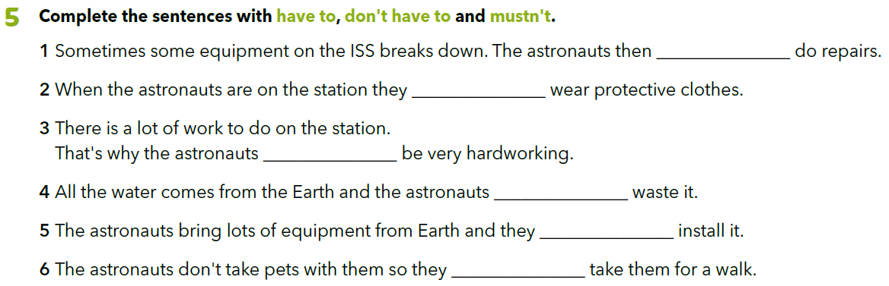
have to
don’t have to
have to
mustn’t
have to
don’t have to

Slide 13


Write about things you have to,
don't have to or mustn’t do.
LEARN MORE!
https://www.e-sfera.hr/dodatni-digitalni-sadrzaji/1ec74b93-0475-4c6f-9d58-e323047cac44/
History of space exploration

Slide 14
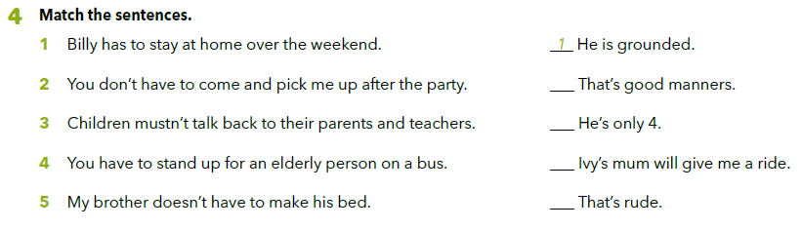
Workbook, p. 23
4
5
2
3

